Slide 1
專題研究進度報告
指導教授：盧奕璋教授
學生：電機三 B05901064 林承德

Slide 2
User Guide
Start
Length of S is unlimited
Length of T ≤ 7168
Match(one of parameters) ≤ 15
Use 256words x 1024 addr sram (32 8x1024 srams)
Set sequence T
Sequence T
Compute
IDLE
Sequence S, parameter
Result

Slide 3
Input Type
Input [127:0] i_s
64 DNA of sequence s, i_s[127:126] represents the former DNA.
Input [6:0] i_s_valid
7’d0 means not valid, 7’b1111111 means there are DNA after i_s.
Other means only the value of i_s are valid.
Input [17:0] i_t
i_t[17] : valid or not
i_t[16:14] :
3’d0 means there are DNAs after i_t
other means only the value of i_t are valud
i_t[13:0] : 7 DNA of sequence, i_t[13:12] represents the former DNA

Slide 4
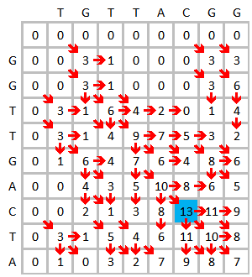



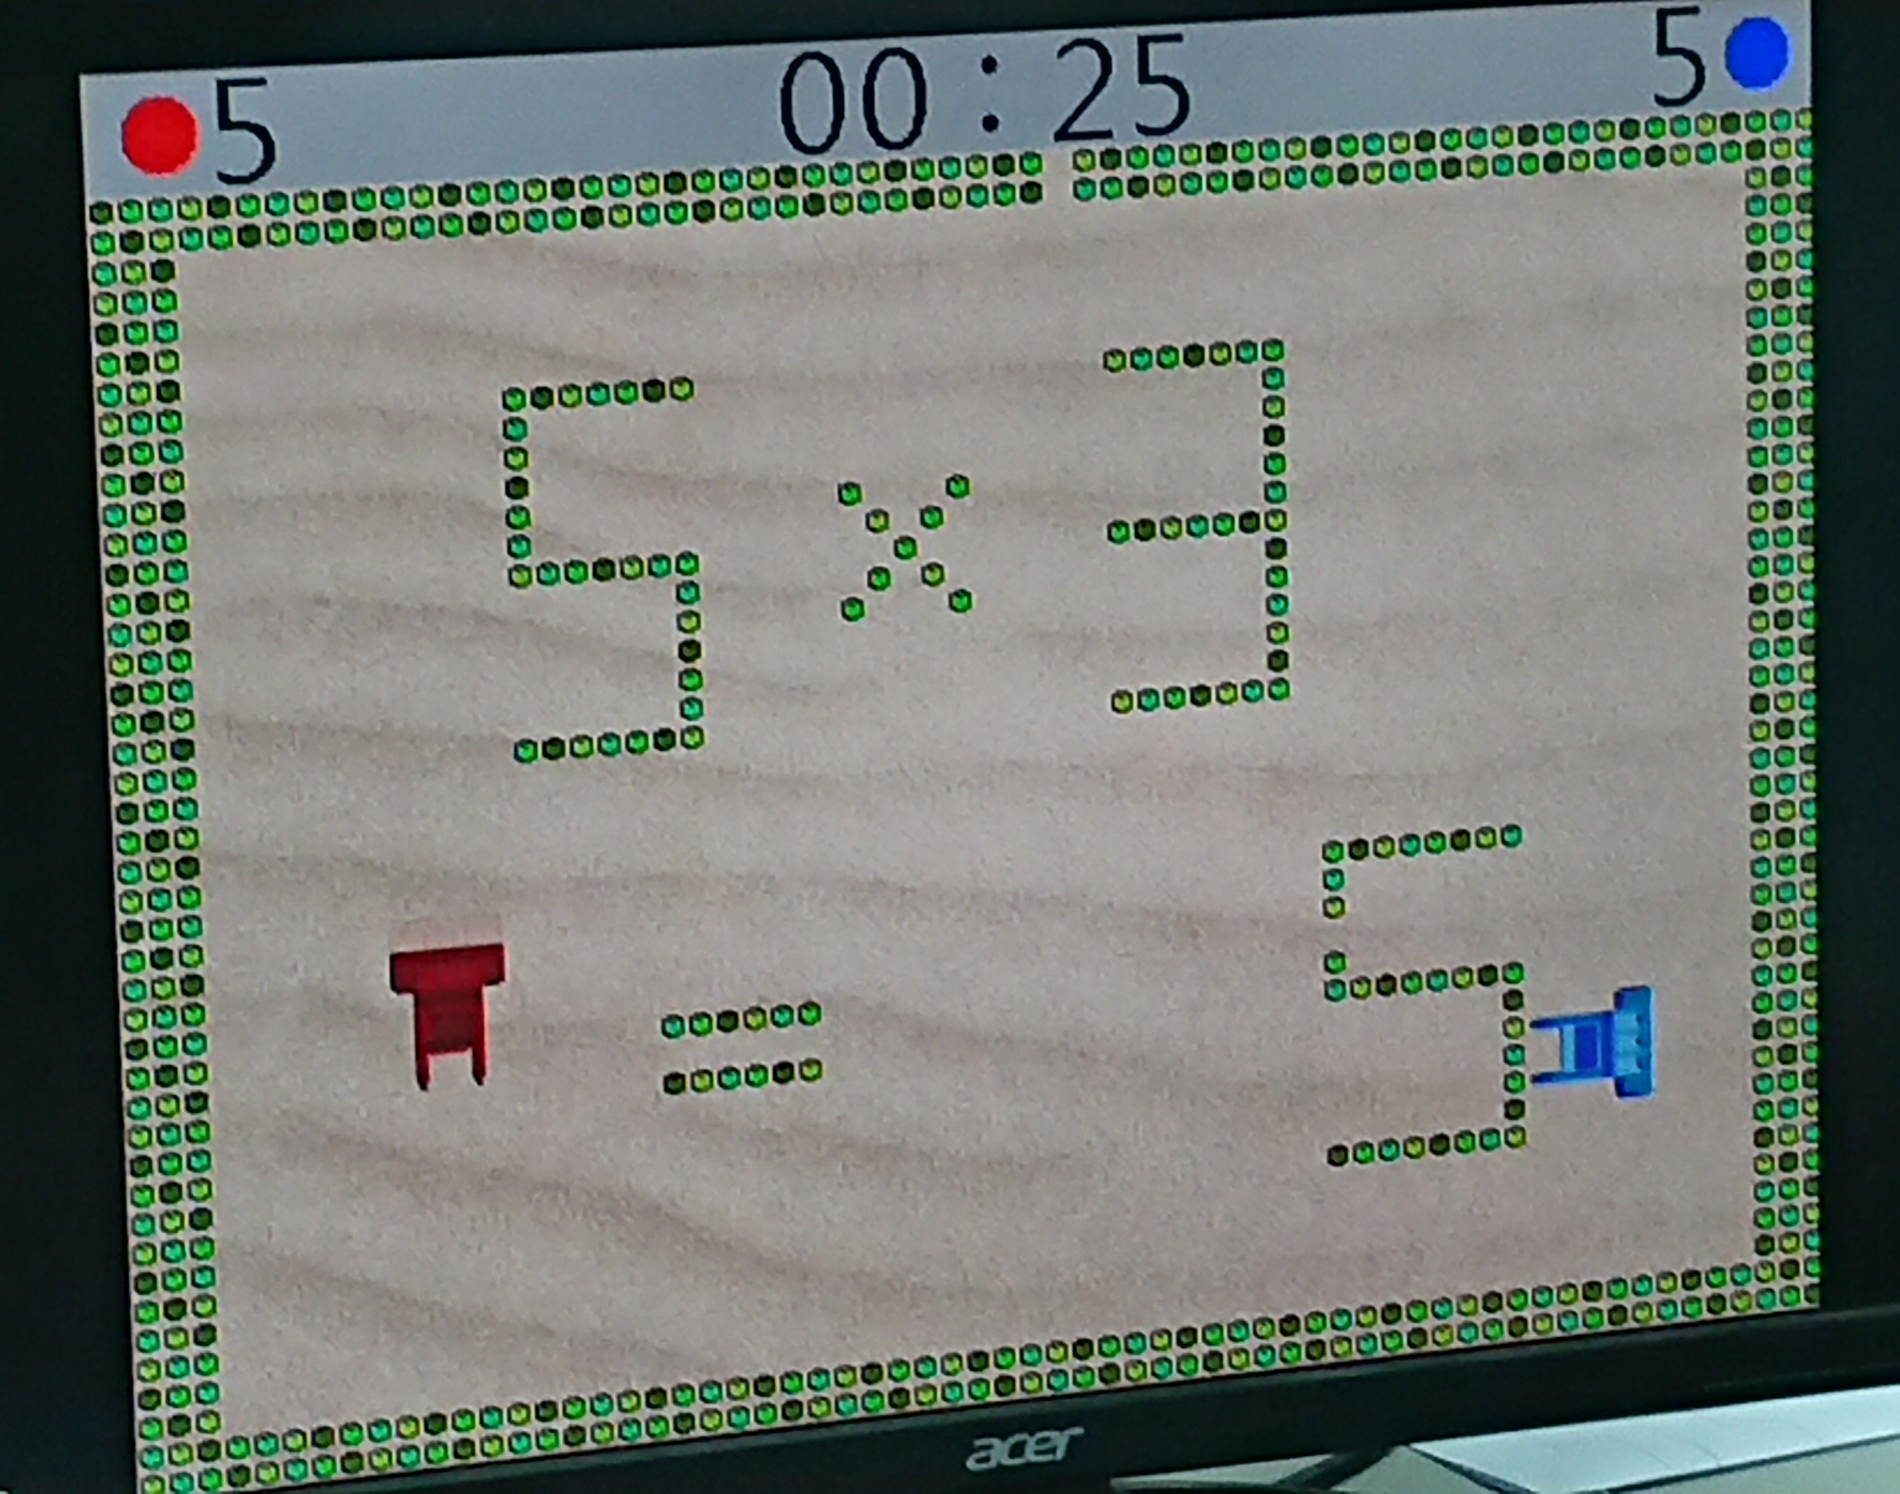

Slide 5
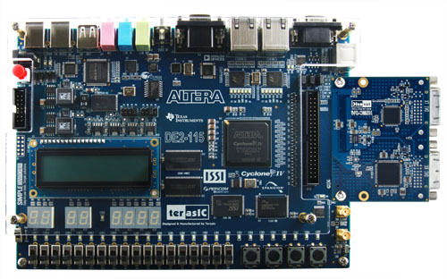
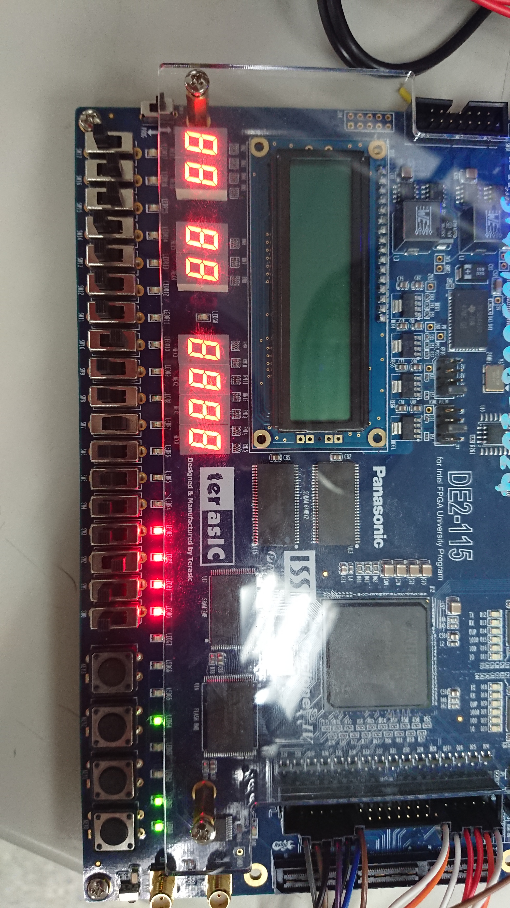
FPGA
Result
LED
State
Start
Set
T
Rst
Match
Mismatch
Alpha
Beta

